Slide 1
FOOD RECOGNITION SYSTEM USING DEEP LEARNING
Under the guidance of Mr.Ravi Kant Kumar
Presented by :
GTS Siddharth (AP21110011421)
Chaitanya Nath (AP21110011422)
Raja Sekhar (AP21110011444)
Lakshmipathi (AP21110011457)
Guna sekhar (AP21110011476)

Slide 2
ABSTRACT
Food recognition using machine learning is a rapidly growing field with a wide range of applications, including dietary monitoring, calorie estimation, and food waste management .This project focuses on creating a robust solution that can identify various food items from images, enabling users to effortlessly track their nutritional intake.
The proposed system employs a combination of computer vision and machine learning algorithms to analyse and classify food items within images. The project involves the collection and pre-processing of a diverse dataset containing images of different types of food. Convolutional Neural Networks (CNNs) are utilized for feature extraction, enabling the model to discern intricate patterns and details crucial.
However, there are still a number of challenges that need to be addressed, such as the lack of large-scale, high-quality food image datasets and the difficulty of recognizing food in real-world conditions.
- Chaitanya AP21110011422

Slide 3
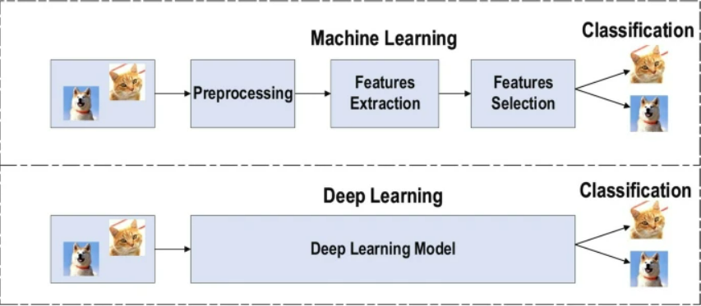
INTRODUCTION
Background :
What is Deep Learning ?
Deep learning is a subfield of machine learning that involves training artificial neural networks on vast amounts of data to enable them to make intelligent decisions without explicit programming.
The term "deep" comes from the use of deep neural networks, which are characterized by having multiple layers (deep architectures) that allow them to learn intricate representations of data.
How Deep Learning is different from Machine Learning :
Machine Learning use s structured data to make predictions ,that means
features are defined in input and organised into tables.
If in case the data is not structured then we have to pre-process the data before taking it to model.
Whereas,Deep Learning algorithm can process unstructured data like text and images.
Deep Learing automates the feature extraction and removes human dependency.
- Chaitanya AP21110011422

Slide 4
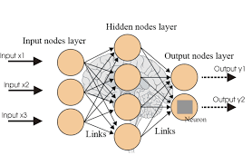
How Deep Learning works :
The fundamental building blocks of deep learning are artificial neural networks, inspired by the human brain's interconnected neurons.
These networks consist of layers of nodes (neurons) that process and transform input data, progressively learning hierarchical features.
Each layer captures different levels of abstraction, allowing the network to learn complex representations of the input data.
There are different types of Deep Learning :
CNN- Used primarily in computer vision and image classification.
RNN- Used in Natural Language Processing and Speech Recognition.
Chaitanya AP21110011422

Slide 5
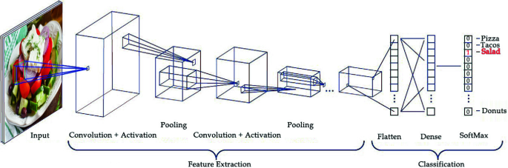
Convulutional Neural Networks:
Digital Image is a binary representation of visual data which contains a series of pixels arranged in a grid like fashion.
CNN Architecture consist of three layers :Convolutional Layer,Pooling Layers,Fully connected Layers.
Convolutional Layer:These are filters that slide over the input to detect patterns like edges,textures and more.
Each feature focuses on a specific feature,learning to recogniseit throough training .
Pooling Layer : Pooling layers downsample the dimensions ,reducing the amount of computation and preserving essential information.
Common pooling methods include MaxPooling where the maximum value in a region is retained.
Fully Connected Layer:These layers connect every neuron to every neuron in the network forming the final layer responsible for better prediction.
Informationed learned from the previous layers is flattened and used to classify.
Chaitanya AP21110011422

Slide 6
CONTEXT :
The "Food Recognition System using Deep Learning" is an innovative project that leverages advanced artificial intelligence techniques to identify and classify various types of food items from images.
Project Focus:
Deep Learning Application: Our project's core objective is the development of a Food Recognition System, utilizing deep learning techniques with a primary emphasis on Convolutional Neural Networks (CNNs).
Architecture Choice:
ResNet-101:Model Selection Rationale: ResNet-101 was chosen due to its robust performance, achieving an impressive 88% accuracy in food recognition.
Fundamental Terminologies: Key Concepts Unveiling: We delved into fundamental terminologies inherent in Deep Learning, unraveling the intricacies of neural networks and their diverse applications.
- GunaSekhar AP21110011476

Slide 7
CNN Exploration: Profound Learning Shift: Delving into the realm of Convolutional Neural Networks marked a profound shift in our understanding of visual data interpretation. Systematic Experimentation: Algorithmic Scrutiny: We systematically experimented with various algorithms and architectures, aiming to discern their efficacy in the context of food recognition. Baseline Model: Initial Framework: A simple Keras model using TensorFlow served as our baseline, providing insights into challenges associated with identifying diverse food items in images. VGG16 Experimentation: Significant Improvement: Our experimentation with VGG16 revealed a noteworthy increase in accuracy, emphasizing the importance of deeper networks for our specific task. VGG19 Enhancement: Model Refinement: Building upon insights gained, we explored VGG19, witnessing further enhancements in our model's performance with an increased accuracy of 78%.
- GunaSekhar AP21110011476

Slide 8
ResNet-50 Implementation: Pivotal Development: Implementing ResNet-50 marked a crucial juncture in our project, introducing residual connections and significantly boosting accuracy to a range between 85% and 89%. Optimal Choice - ResNet-101: Informed Decision: Choosing ResNet-101 was informed by meticulous evaluation, showcasing consistent accuracy ranging between 88% and 89%. It emerged as the optimal choice, marrying depth and efficiency to address the complex task of food recognition.
-GunaSekhar AP21110011476

Slide 9
METHODOLOGY
Dataset Creation:
Our project's core involved creating a robust dataset to underpin the training of our Food Recognition System. This wasn't a mere collection but a thoughtfully curated assembly across 15 food classes. Diversity was key, leading to meticulous selection from various online sources. The deliberate curation aimed for representation across culinary contexts, enriching the dataset with variations in colors, shapes, and presentations. This strategic approach equipped our model with adaptability, allowing it to effectively generalize across diverse visual representations of foods. In essence, the dataset wasn't just images; it was a strategic asset enhancing our model's adaptability and accuracy.
Algorithmic Exploration:
Our journey began with a foundational Keras model using TensorFlow, offering crucial insights into food recognition nuances. Seeking refinement, we explored intricate architectures, starting with VGG16 and progressing through VGG19. Advancing further, ResNet-50 showcased a significant accuracy increase, ranging from 85% to 89%. The pinnacle of our experimentation was the adoption of ResNet-101.
- RajaSekhar AP21110011444

Slide 10
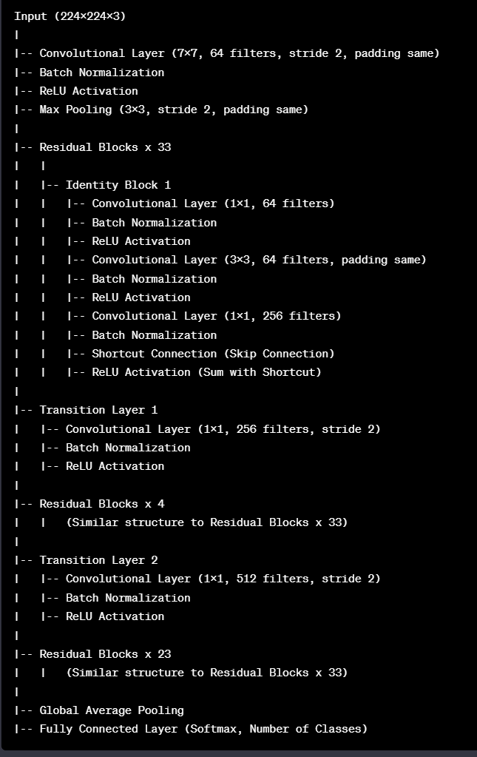
ARCHITECTURE OF RESNET101
ResNet-101, lauded for its deep architecture and ingenious use of skip connections, emerged as the pinnacle of our algorithmic exploration. Its adeptness in capturing intricate features, coupled with a balanced trade-off between depth and computational efficiency, marked a significant leap in our project's performance. The decision to embrace ResNet-101 was underpinned by its consistent accuracy, ranging between 88% and 89% during our iterative experimentation.
- GunaSekhar AP21110011476

Slide 11
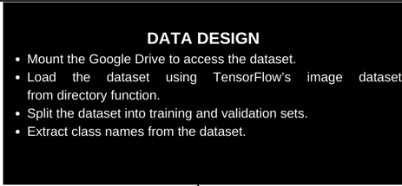
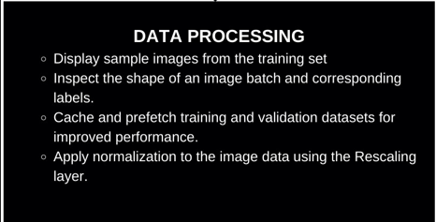
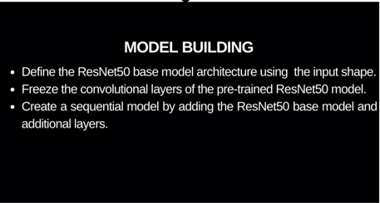
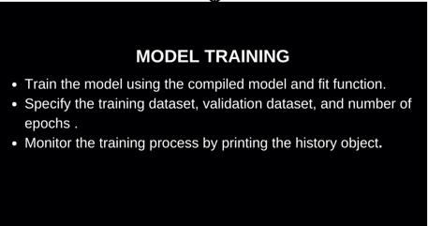
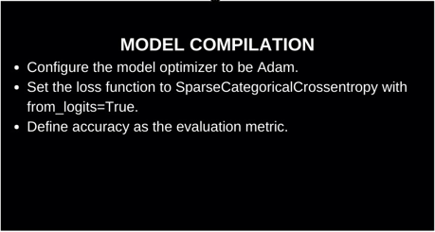
WORKFLOW OF PROJECT
- Siddharth AP21110011421

Slide 12
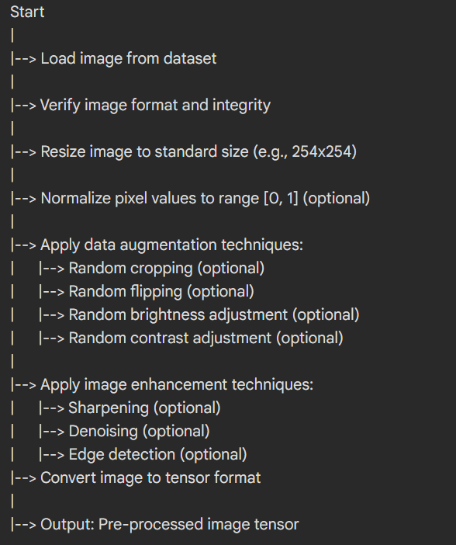
STEPS IN IMAGE PROCESSING
Verify image format and integrity: Ensure the image is in a valid format (e.g., JPEG, PNG) and not corrupted.
Resize image to standard size: Adjust image dimensions to a standard size, like 254x254, for uniformity and reduced computational complexity.
Normalize pixel values to range [0, 1]: Scale pixel values of the image to lie within the range of [0, 1], enhancing convergence for machine learning models.
- Siddharth AP21110011421

Slide 13
Apply data augmentation techniques: Techniques like random cropping, flipping, brightness, and contrast adjustments increase dataset size and variability, preventing overfitting.
Apply image enhancement techniques: Use methods such as sharpening, de-noising, and edge detection to improve image quality, aiding the model in recognizing features.
Convert image to tensor format: Transform the image into tensor format, a common data structure in machine learning, based on the chosen framework.
Pre-processed image tensor: The final output of the pre-processing pipeline, a transformed image in tensor format, ready for use in tasks like image classification or object detection.
- Siddharth AP21110011421

Slide 14
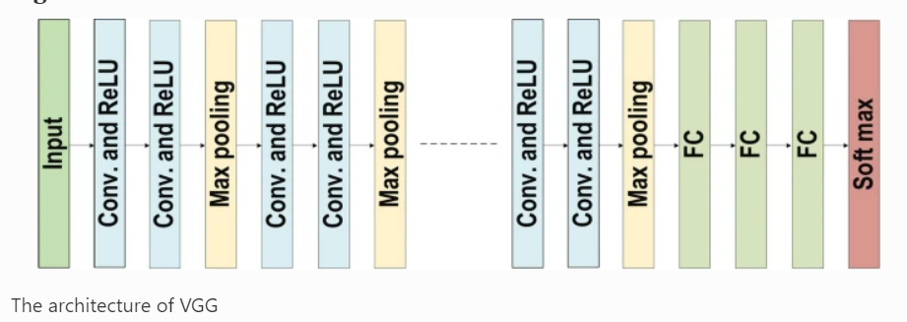
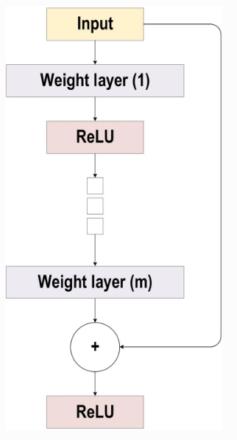
ResNet Architecture
VGG Architecture
- Siddharth AP21110011421

Slide 15
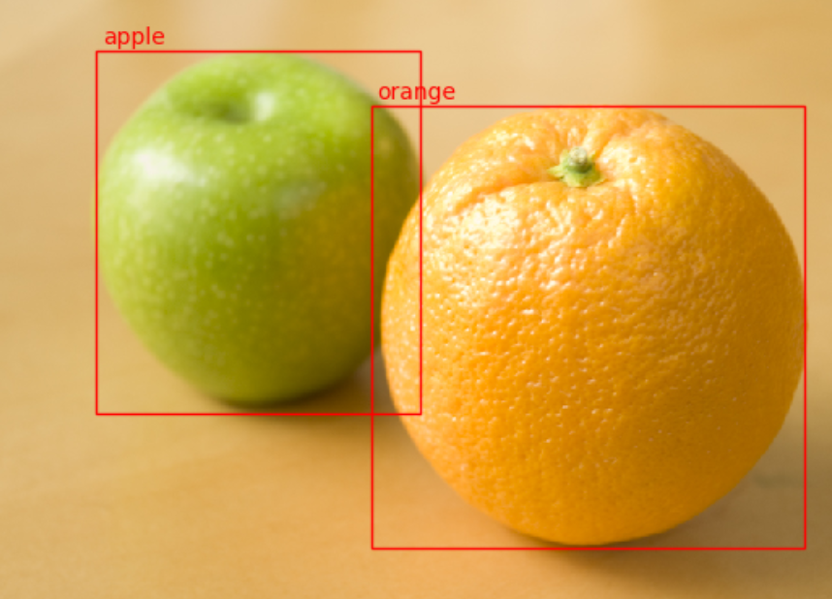
Results and Discussion
We conducted experiments with four different convolutional neural network (CNN) architectures, namely VGG16, VGG19, ResNet50, and ResNet101, to classify images of Indian food items. The final results, including the accuracy achieved on the test set, are as follows:
VGG16: 75% VGG19: 78% ResNet50: 85% ResNet101: 88%
- Lakshmipathi AP21110011457

Slide 16
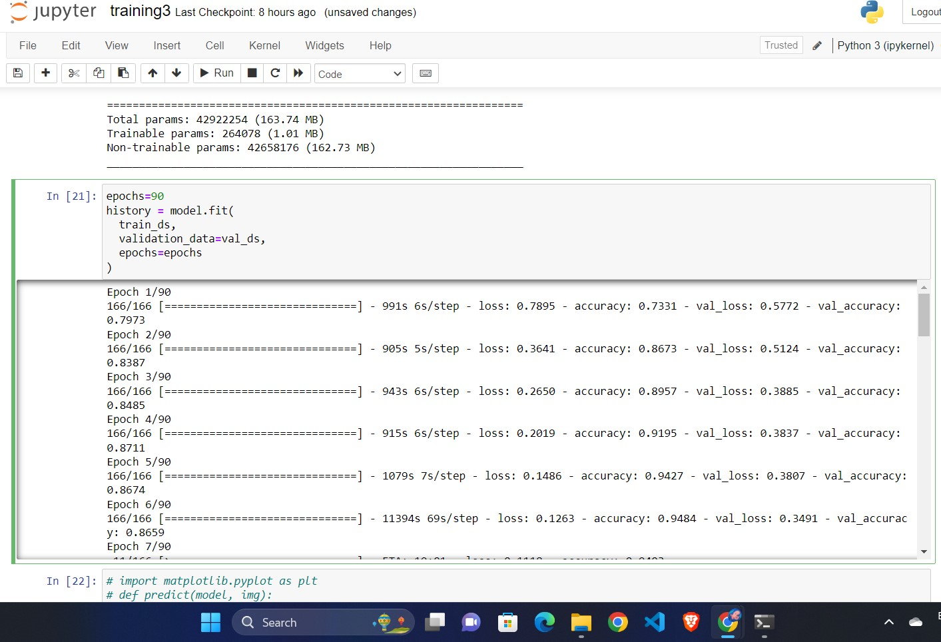
TRAINED MODEL WITH USER DATA
- Lakshmipathi AP21110011457

Slide 17
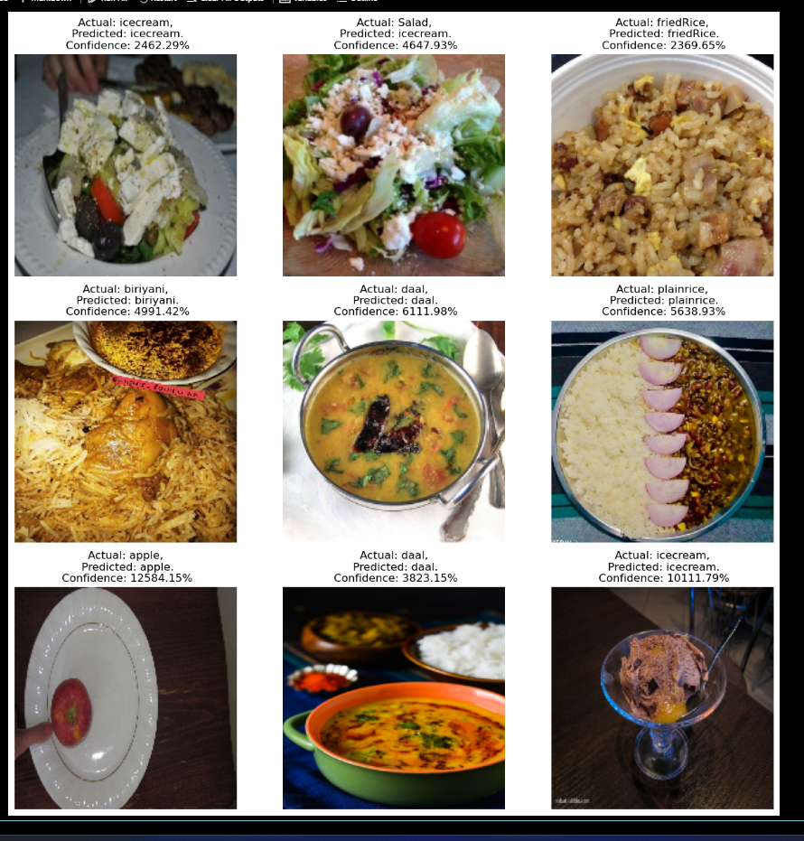
PREDICTIONS USING RESNET101
- Lakshmipathi AP21110011457

Slide 18
CONCLUSION
Our project journey has been marked by a relentless pursuit of precision in food recognition. From the foundational understanding of Deep Learning and CNNs to the strategic selection of ResNet-101, every step in our journey has been a deliberate stride towards a more accurate and efficient Food Recognition System.
Our Food Recognition System, empowered by ResNet-101, stands as a testament to the potential of deep learning in image recognition. The amalgamation of a thoughtfully curated dataset, iterative algorithmic exploration, and the support of various entities has resulted in a system poised to make substantive contributions to diverse applications in the culinary landscape.
- Lakshmipathi AP21110011457

Slide 19

DESKTOP SOFTWARE
Windows 10, 64 bits (PC or Mac computers using Boot Camp). (Windows 10 and Windows 11*)
CPU (Intel i5/ i7/ Ryzen 7).
GPU that is compatible with OpenGL 3.2. (integrated graphics cards Intel HD 4000 or above).
Small projects (under 100 images at 14 MP): 4 GB RAM, 10 GB HDD Free Space.
- Lakshmipathi AP21110011457

Slide 20
Thank You

